Slide 1



Petrography of New Basaltic Shergottite Northwest Africa 17234
Arizona Space Grant Symposium
April 19, 2025

Slide 2
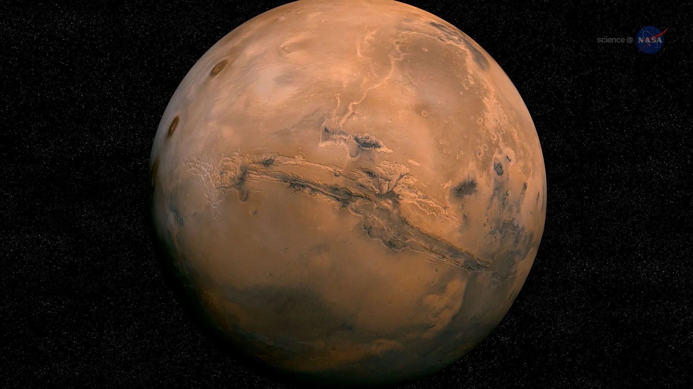
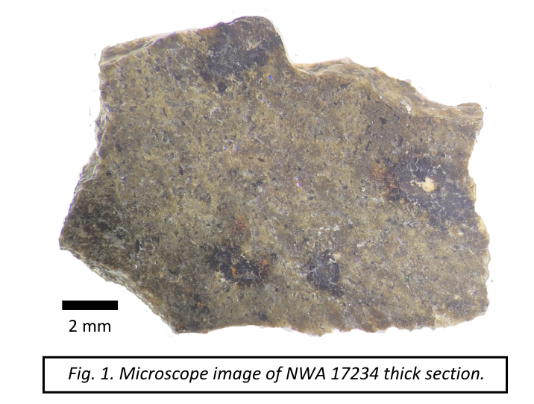
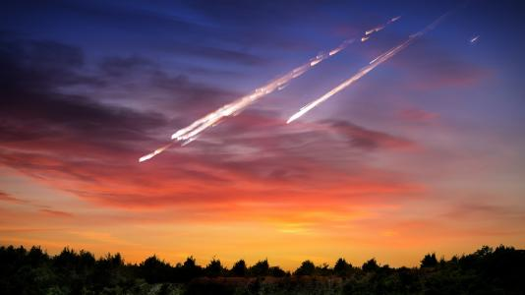
Background
337 Martian meteorites in the Meteoritical Bulletin.
Divided into shergottites, nakhlites, chassignites
Shergottites (largest group): basaltic, olivine-phyric, poikilitic types
Mars impact crater minimum Ø: 3 km (Head et al. 2002, Science)
Record geologic processes that have occurred on Mars.
This project looks into classifying a new Martian meteorite and constraining its petrogenesis.
Image from NASA
Image from Shutterstock/Triff/NASA

Slide 3
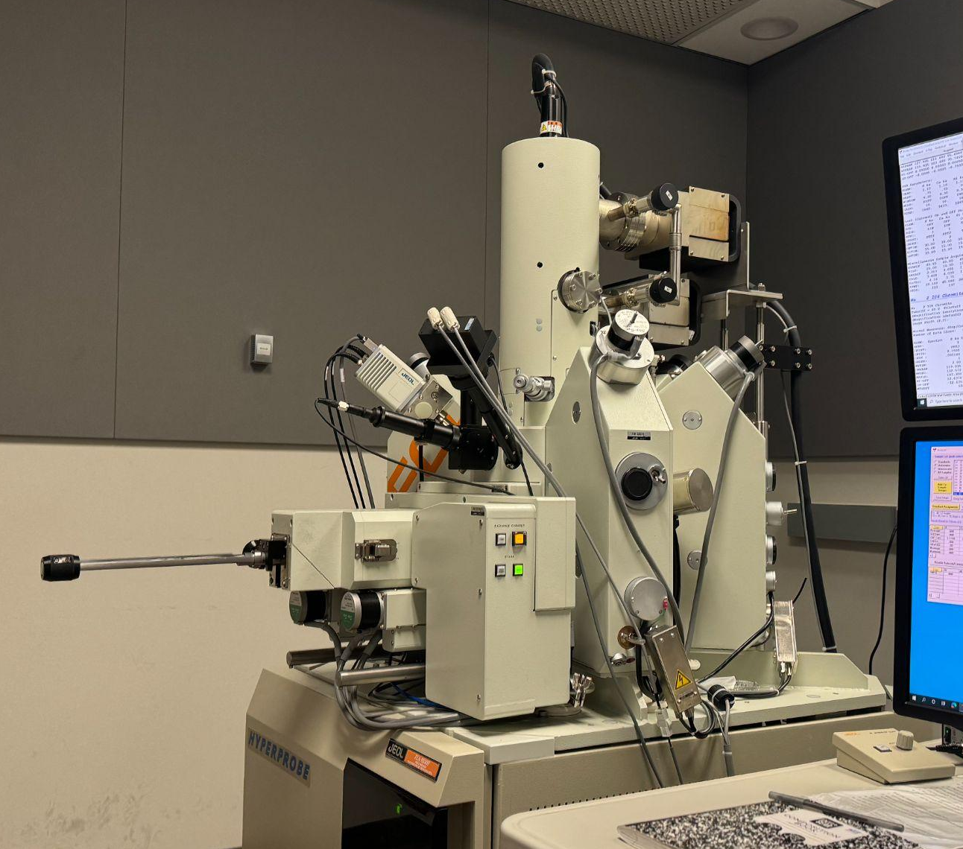
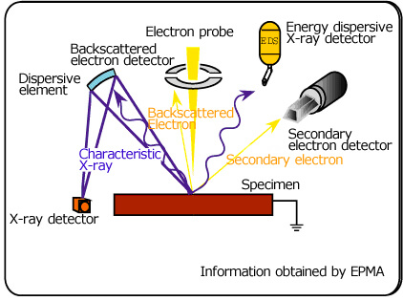
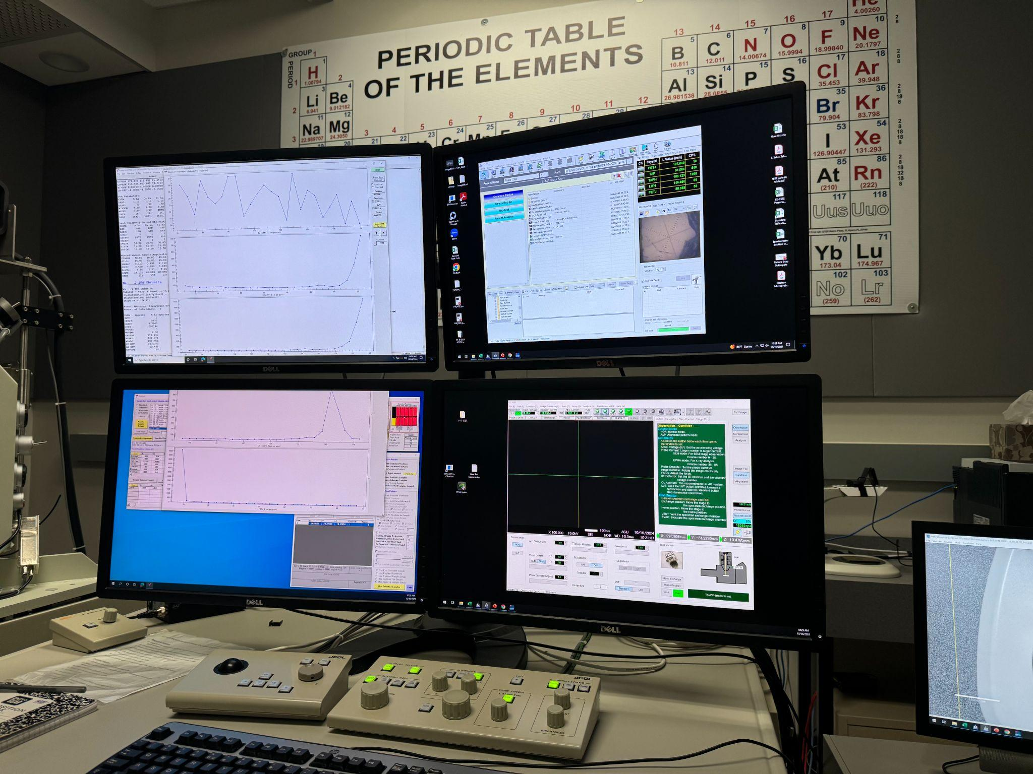
Methods:
The ASU JEOL JXA-8530F electron microprobe was used to gather petrographic data, X-ray intensity mapping, EDS and WDS.
How does this work?
Image from JEOL
Notes:
What sections were scanned?

Slide 4
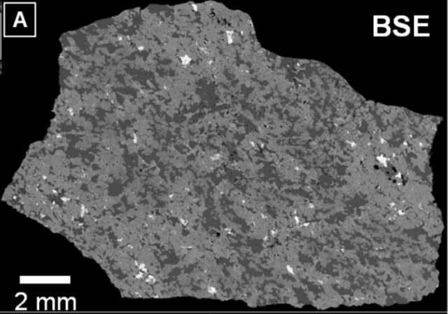
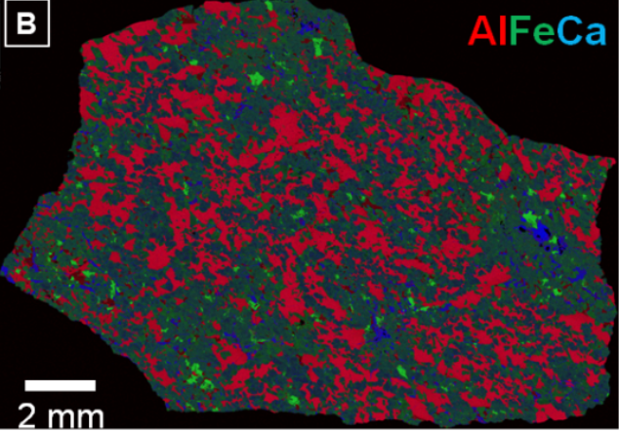
Results:
Foliated, granular cumulate texture of 60 vol% pyroxene and 30 vol% maskelynite, 6 vol% phosphates, and 4 vol% magnetite and pyrrhotite.
No olivine found
A: backscattered electron image of NWA 17234.
B: Composite X-ray intensity map of NWA 17234.

Slide 5
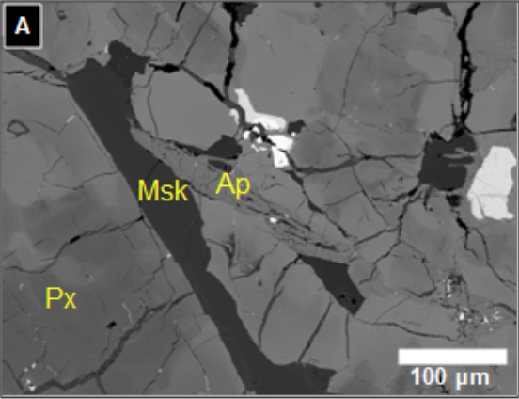
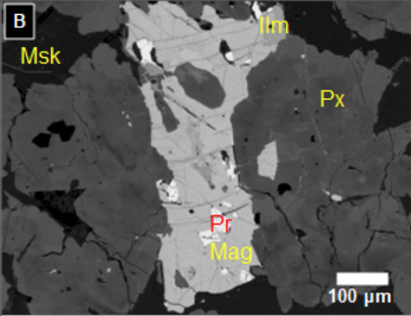
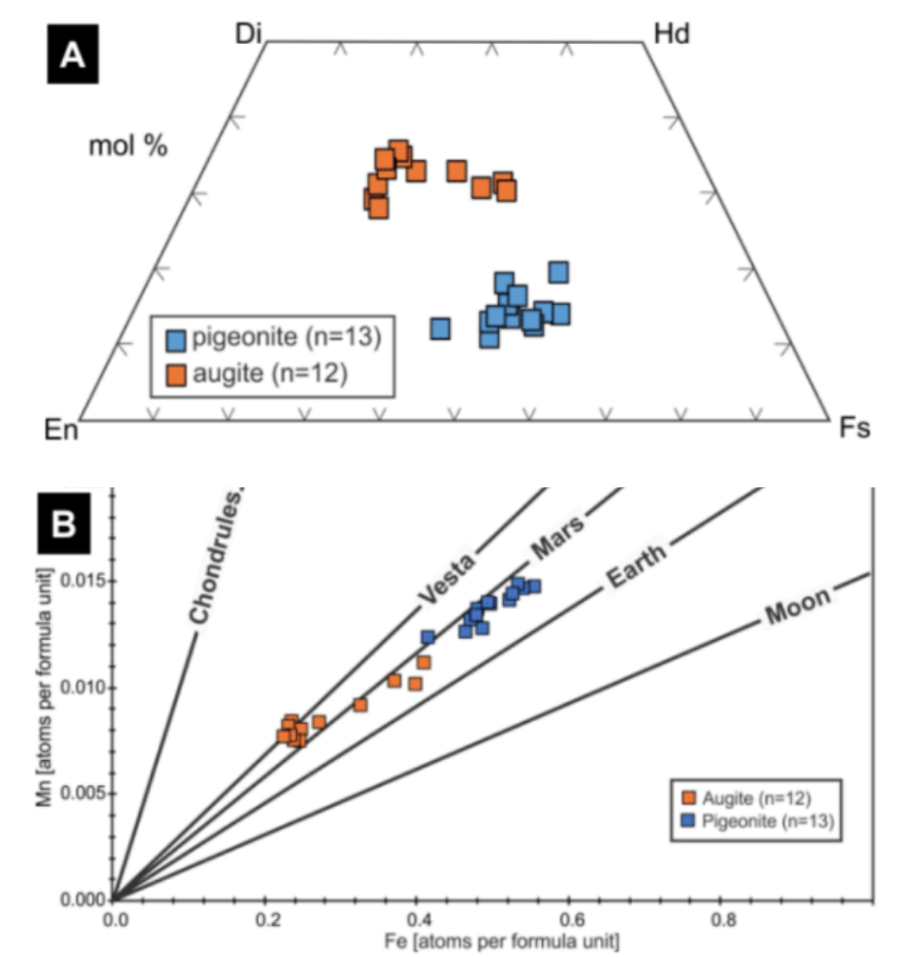
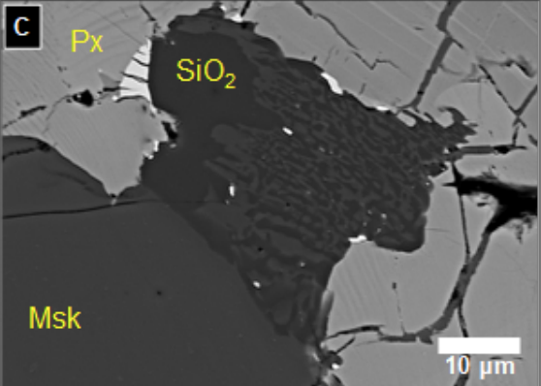
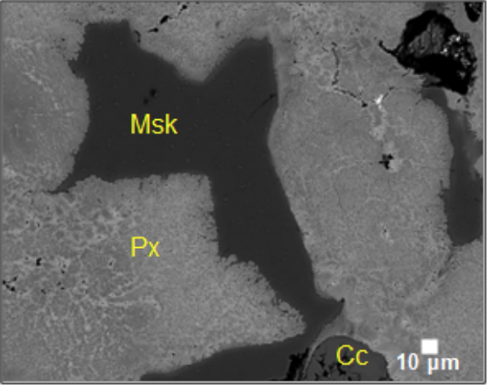
Results continued:
BSE image. A - Fractured apatite (Ap) next to pyroxene (Px) and interstitial maskelynite (Msk).
BSE image. B - Magnetite (Mag)-ilmenite (Ilm)-pyrrhotite (Pr) assemblage.
D
Pyroxene composition in NWA 17324. A - Pyroxene quadrilateral. B - Fe/Mn plot after (Papike 1998, Rev. Min.).
BSE image. C - Graphic intergrowth of SiO₂ with feldspathic phase.
BSE image. D - Shock melt pocket with recrystallized pyroxene,
maskelynite and calcite (Cc)-filled vug (terrestrial alteration).

Slide 6
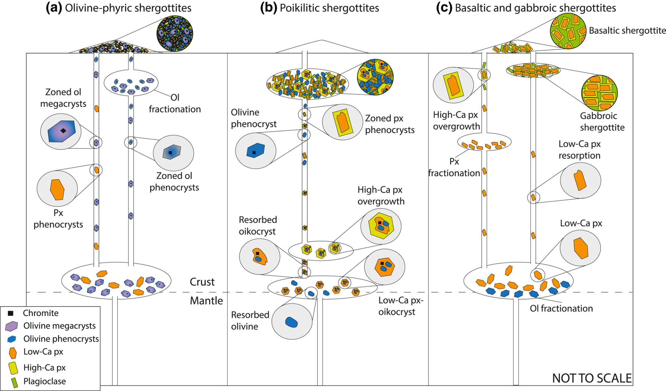

Discussion:
Shock pressures >28 to 32 GPa (Stöffler et al. 2018, Met. Planet. Sci.).
Similar in texture and composition to ~60 other stones to which it is potentially paired (Met. Bull.).
Terrestrial alteration not pervasive, but evident.
Basaltic shergottites like NWA 17234 record crystallization and fractionation at depth, followed by solidification in a near-surface volcanic flow (Udry et al. 2020, JGR; Orr et al. 2022, Met. & Planet. Sci.).
Image from Udry et al. (2020, JGR)
Notes:
Should i switch the positions of slide 5 and 6?

Slide 7
Expanding on the project!
Produced an official classification for NWA 17234 as a new meteorite in the Meteoritical Bulletin.
Presented our work as a poster at the 56th Lunar & Planetary Science Conference.
Future work aims to measure trace element composition of NWA 17234 to further refine its petrogenetic history.

Slide 8
Thank you!
Thank you to my mentor, Dr. Wadhwa!
A special thank you to Dr. Axel Wittmann and Dr. Laurence Garvie.
Supported through the ASU/NASA Space Grant, School of Earth and Space Exploration, and Buseck Center for Meteorite Studies.

